Slide 1

Test review

Slide 2
Test review
Know your vocabulary related to computer hardware, functions and peripheral devices/ peripherals (périphériques)
Know instructions vocabulary and sequence markers(first, then, once you have done x…)
Know how to ask questions present and past tenses
Present perfect
You will be doing some translating
Look at your test corrections
Speed is essential, but make sure to be thorough (rigoureux, précis, relire et corriger avant de rendre la copie, AVOID making careless errors (fautes d’inattention)

Slide 3
What are the question words ?
Questions
Who - Where - When
Why - What
- Whose « Whose mouse is this? » (A qui est cette souris? )
Which (Lequel) « Which software should we add to the hardrive? »

Slide 4
Questions
How (Comment/combien)
« How are you? » « How old are you? »
- How much (time, coffee, money, data, information, advice, news ) How much data do we have to show?
« How much does a laptop cost? » « How much is it? »
« How much time does it take to set up? »
How many – if you can count it! How many gigabytes is it? How many gigabytes does it have? How many dollars do you have ?

Slide 5
Questions
How
How long (Depuis quand/pendant combien de temps) « How long did you live in California ? » Vs « How long have you lived in Sète? »
How often (avec quelle fréquence) How often do you see your friends ? (« A quelle fréquence voyez-vous vos amis? »)

Slide 6
What are the helping words (auxiliaires) in questions?
Questions
Present tense
All verbs except to be (être) : Do / Does (he, she, it)
What time do you arrive at the university?
How much memory does it have ? Does she know computer programming?
VS – to be questions = NO Do/Does
- Are you a computer programmer? How is it mounted? How many programmers are in this office?

Slide 7
Don’t forget the negative forms
Questions
I don’t arrive at the university until 8am.
This laptop doesn’t have a lot of memory.
We don’t know how to program in C.
VS – to be
I’m not a computer programmer.
It isn’t mounted on the motherboard.
There aren’t any programmers in the office.

Slide 8
Questions in the past
Questions
Main verbs : simply use « did » never changes !!!
Where did you put my USB drive? I can’t find it!
When did Steve Jobs create Apple?
VS – to be please learn this once and for all
Where was Steve Jobs when he met S. Wozniak?
Were you able to find the SATA cables you needed? (Est-ce que vous avez pu trouver… Revoir Can/Could)
Which laptop was the best choice?

Slide 9
Questions
Present tense
Don’t forget : the present progressive…..
= en train de faire qqchose
TPR !!

Slide 10
1. I (fix) .................................................. the computer. 2. Jimmy (buy) ..................................................... an audio card. 3. I (run) .................................................. scandisk. 4. Sue and Walter (format) .......................................... their laptops
Questions

Slide 11
Questions
Don’t forget the negative forms
- What are you doing ? I’m fixing the computer.
What is Jimmy buying? He is buying an audio card. He isn’t buying a CPU.
What are you running? /Are you running a scandisk? You’re not running a scandisk.
-What are they formatting ? They’re formatting their laptops. They’re not formatting their PCs.

Slide 12
Questions
A quick exercise with « wh » questions….
Present «wh » questions ex D.
+
I can send you some practice questions w/answers

Slide 13
Questions
Quelles sont les 4 composantes fonctionnelles d’un ordinateur ?
What are the 4 functional components of a computer ?
Qu'est-ce que ce nouveau logiciel vous permet de faire ?
What does this new software allow/enable you to do? It allows you to…..

Slide 14
Questions
Où est-ce qu’il faut fixer les RAM sticks?
Where do you have to fix, secure, attach, place, put, connect, insert the Ram sticks ? In the RAM slots!
Quelles seront les caractéristiques des ordinateurs du futur et à quoi serviront-ils ?
What features will computers have in the future and what will they be used for? They will be used for helping, making, constructing..

Slide 15
How do you say…..?
Symbols on keys (touches)
- « hyphen »
_ « underscore » « underline »
@ « at »
.com « dot com »
# « hashtag »
/ « slash » « forward slash »
« Back slash »
Question mark
! « exclamation point »
: « colon » ; « semi-colon »
, « comma »
period
« tiré du 6 »
« tiré du 8 »
@
www.holiday.com
#
/
\
?
!
: ;
,
.

Slide 16
How do you say…..?
Symbols on keys (touches
- « Tilde »
- « asterisk »
- pound
- percent
- Open parenthesis
- Close parenthesis
- open bracket
- Close bracket
- plus, minus, equals
- Less than symbol
- Greater than symbol
~
« * »
£
%
(
)
[
]
+ , -, =
<
>

Slide 17
Next review session!

Slide 19
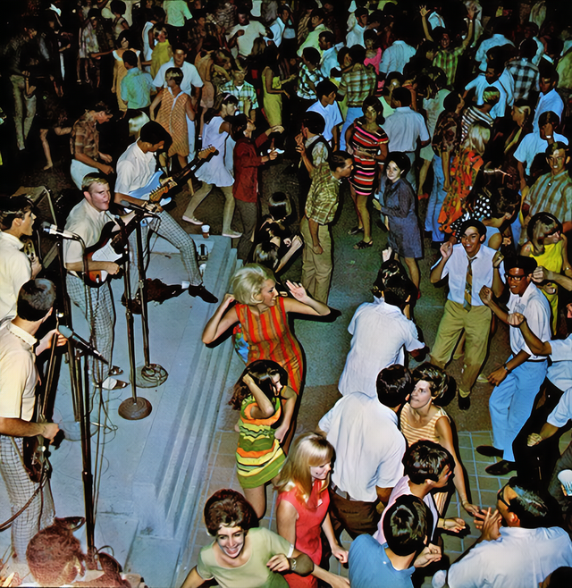
When did this scene take place?

Slide 20
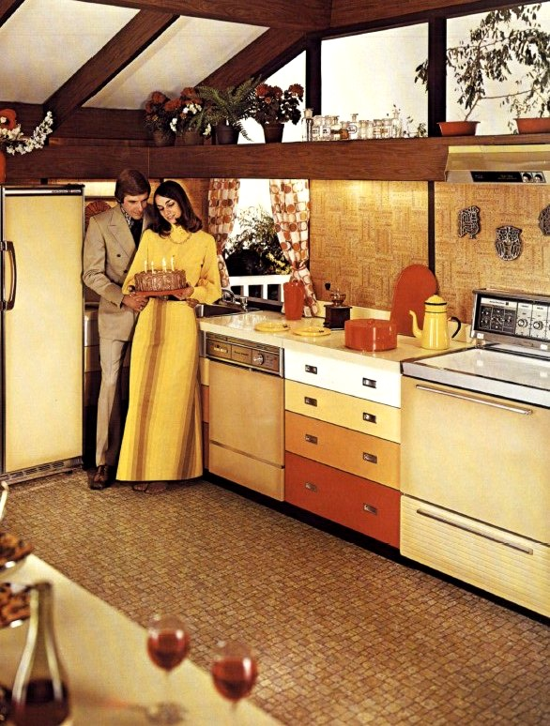
When did this scene take place?

Slide 21
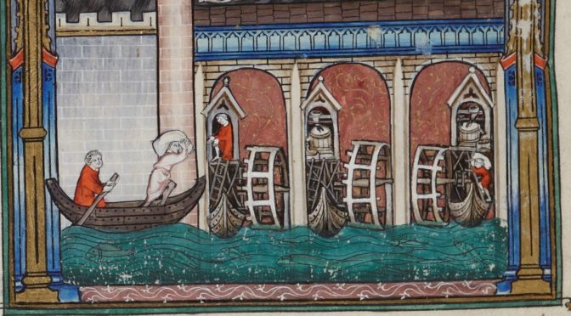
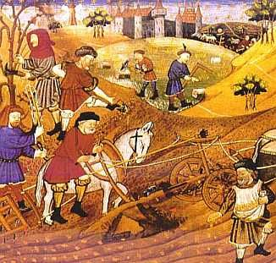
When did this scene take place?

Slide 22

When did this scene take place?

